Slide 1
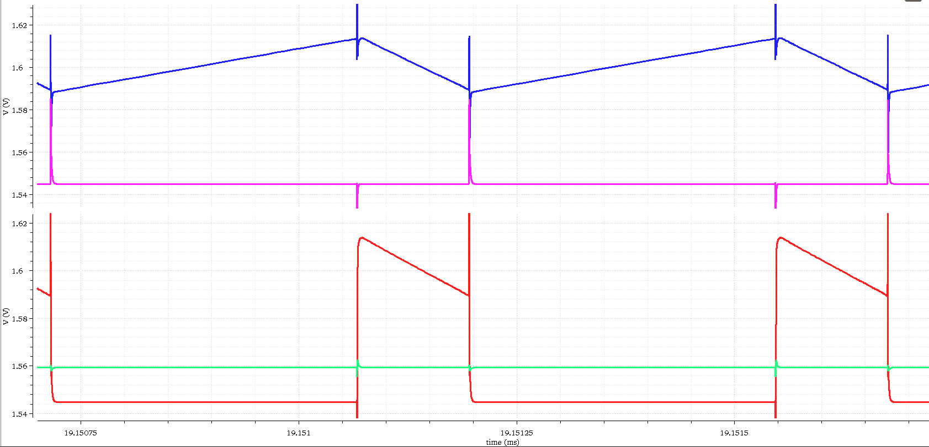
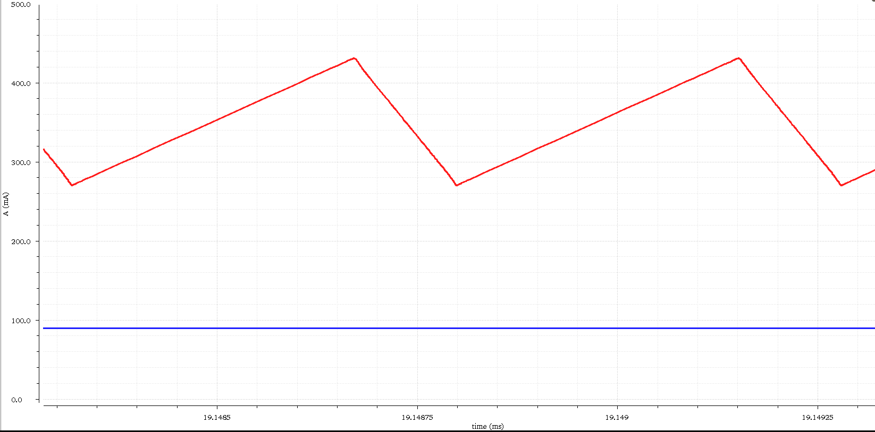
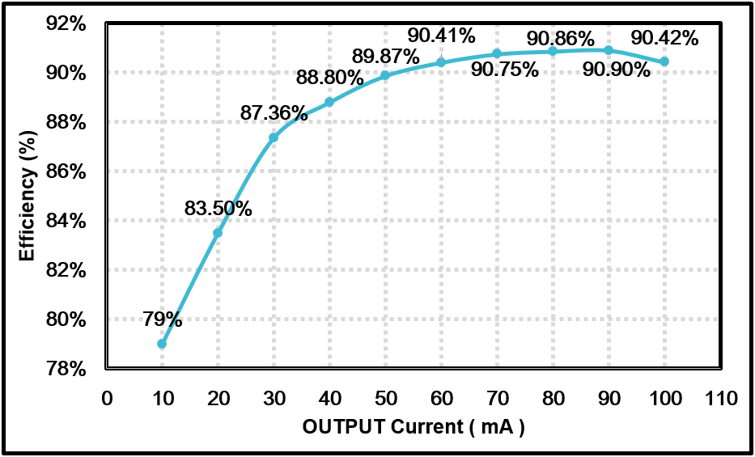
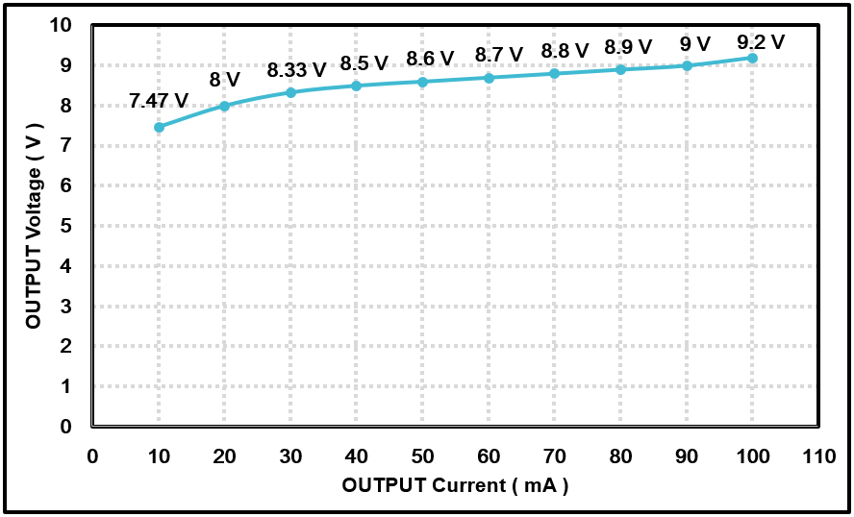
      Donghee Cho and Minkyu Je
      Department of Electrical Engineering, KAIST, KI B/D (E4) 415C, Daejeon, Korea Tel : +82-42-350-7437, E-mail address : dh456@kaist.ac.kr, mkje@kaist.ac.kr
Research Activities related to Attachable Phototherapeutics Center for e-Healthcare
A Boost OLED Driver with aging compensation for light therapy platform
Introduction
In the light therapy system, the organic light emitting diode (OLED) is considered as a strong candidate because of its advantageous characteristics in mechanical flexibility as surface light source, uniformity, and power consumption. Because the OLED luminance is proportional to its forward current and the threshold voltage tends to shift by aging, the current through the OLED should be controlled instead of the applied voltage.
2
3
I_{L}
1
4
Motivation
I_{OLED}
I_{OLED} = I_{L} X D’
The waveforms of the OLED Current Estimator
The transistor based conventional current sensor can not be used in a boost DC-DC converter because of high voltage issue.
By using the RC filter based Inductor Current Sensor, the current regulation element which incurs the additional power loss is efficiently removed.
The OLED Current Estimator which is composed of three gm cells converts the voltage information from a Inductor Current Sensor to the exact inductor current.
A Concept diagram of Wearable light therapy system
A 2 stage conventional OLED Driver
Simulation Results
In wearable light therapy system, the high efficiency of the OLED driver is needed because of the flexible battery which has low output power.
Conventional OLED drivers typically consist of two separate stages, a power stage and a current driving stage for OLED current driving.
The two-step process incurs cascaded power losses and further degrades the total system efficiency.
Integrated OLED driver is needed to improve the efficiency of the system.
Circuit Implementation
1
2
3
4
In 1 MHz switching frequency, the peak efficiency is 90.9 % at 90 mA load current.
The integrated circuit is designed as continuous current mode(CCM), and the load current can be changed from 10 mA to 100 mA.
The proposed high efficiency integrated OLED driver
Summary & Conclusion & Acknowledgement
In the wearable light therapy system, the flexible battery which has the low output power is used. Therefore, the high efficiency of the OLED driver is required.
The proposed OLED driver which integrates the power stage and OLED current driving stage as a single-stage can achieve the 90.9 % peak efficiency.
The chip fabrication was supported by the IC Design Education Center(IDEC), Korea.

